Slide 1
Unit 5
Control Structure

Slide 2
Statement
Statements is an executable part of the program it will do some action.
A statement is a complete direction instructing the computer to carry out some task.
In general all arithmetic actions and logical actions are falls under statements Categories
There are few categories of statement
Null Statement
Expression Statement
Compound Statement
Selection Statement
Iterative Statement
Jump Statement

Slide 3
Null Statement
Writing only a semicolon indicates a null statement.
Thus ; is a null or empty statement
; // null statement
This statement is generally used in for and while looping statement

Slide 4
Expression Statement
It consist of an expression followed by a semicolon
The execution statement causes the expression to be evaluated
Few Examples for expression Statements
X = Y + 10 ;
20 > 90;
a ? b : c ;
a = 10 + 20 * 30;

Slide 5
Compound Statement
Compound statement is combination of several expression statements. Compound Statement is Enclosed within the Braces { }.
Compound statement is also called as Block Statement.
There is no need of any semicolon at the end of Compound Statement.
Example for Compound Statement
{ int a=10,b=20,c; c = a + b; printf(“value of C is : %d n”,c); }

Slide 6
Selection Statement
A selection statement is a one in which one group of statement is selected from several available groups, depending on the outcome of a logical test
Selection Statements are used in decisions making situations
if
if…else
switch

Slide 7
The if Statement
Syntax
if (testExpression)
{
// statement(s)
}
How if statement works?
The if statement evaluates the test expression inside the parenthesis.
If the test expression is evaluated to true (nonzero), statement(s) inside the body of if is executed.
If the test expression is evaluated to false (0), statement(s) inside the body of if is skipped from execution.

Slide 8
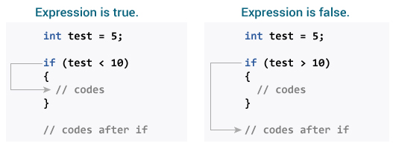

Slide 9
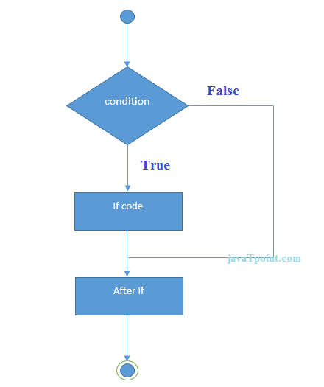

Slide 10
Write a program that reads a number from user and display “Hello!!” if the number inputted is greater than 10.

Slide 11
C if...else statement
The if statement may have an optional else block. The syntax of if..else statement is:
if (testExpression)
{
// statement(s) inside the body of if
}
else
{
// statement(s) inside the body of else
}

Slide 12
How if...else statement works?
If test expression is evaluated to true,
statement(s) inside the body of if statement is executed
statement(s) inside the body of else statement is skipped from execution.
If test expression is evaluated to false,
statement(s) inside the body of else statement is executed
statement(s) inside the body of if statement is skipped.

Slide 13
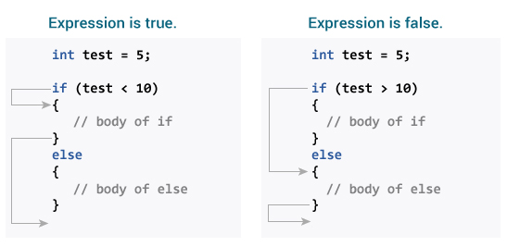

Slide 14
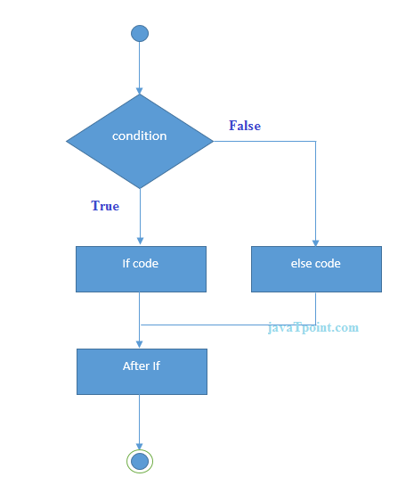

Slide 15
Example
#include<stdio.h>
void main()
{
int number;
printf("enter a number:");
scanf("%d",&number);
if(number%2==0)
{
printf("%d is even number",number);
}
else
{
printf("%d is odd number",number);
}
}

Slide 16
Write a program that reads a student score in C programming in the exam. If score is greater than 20, display “congratulation!! You have pass the exam” otherwise display “Sorry!!! You have fail the exam”.

Slide 17
if...else Ladder (if...else if....else Statement)
The if...else statement executes two different codes depending upon whether the test expression is true or false. Sometimes, a choice has to be made from more than 2 possibilities.
The if...else ladder allows you to check for multiple test expressions and execute different statement(s).

Slide 18
Syntax of nested if...else statement.
if (testExpression1) {
// statement(s)
}
else if(testExpression2) {
// statement(s)
}
else if (testExpression 3) {
// statement(s)
}
else {
// statement(s)
}

Slide 19
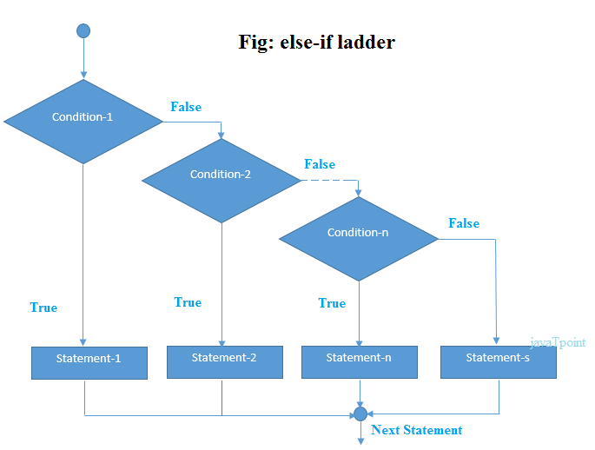

Slide 20
Write a program that accepts income of a person in annual basis and display his class according to following conditions
below 50,000 class C
50,001-3,00,000 class B
3,00,001-10,00,000 class A
above 1000000 class A+

Slide 21
Nested if...else
It is possible to include if...else statement(s) inside the body of another if...else statement.
This program below relates two integers using either <, > and = similar like in if...else ladder example. However, we will use nested if...else statement to solve this problem.

Slide 22
Example
#include <stdio.h>
#include<conio.h>
void main()
{
int n1, n2;
printf("Enter two integers: ");
scanf("%d %d", &n1, &n2);
if (n1 >= n2)
{
if (n1 == n2)
{
printf("Result: %d = %d",n1,n2);
}
else
{
printf("Result: %d > %d", n1, n2);
}
}
else
{
printf("Result: %d < %d",n1, n2);
}
getch();
}

Slide 23
Write a program to calculate whether the given year is leap year or not.

Slide 24
C switch...case Statement
The if..else..if ladder allows you to execute a block code among many alternatives. If you are checking on the value of a single variable in if...else...if, it is better to use switch statement.
The switch statement is often faster than nested if...else (not always). Also, the syntax of switch statement is cleaner and easy to understand.

Slide 25
Syntax of switch...case
switch (n)
{
case constant1:
// code to be executed if n is equal to constant1;
break;
case constant2:
// code to be executed if n is equal to constant2;
break;
.
.
.
default:
// code to be executed if n doesn't match any constant
}

Slide 26
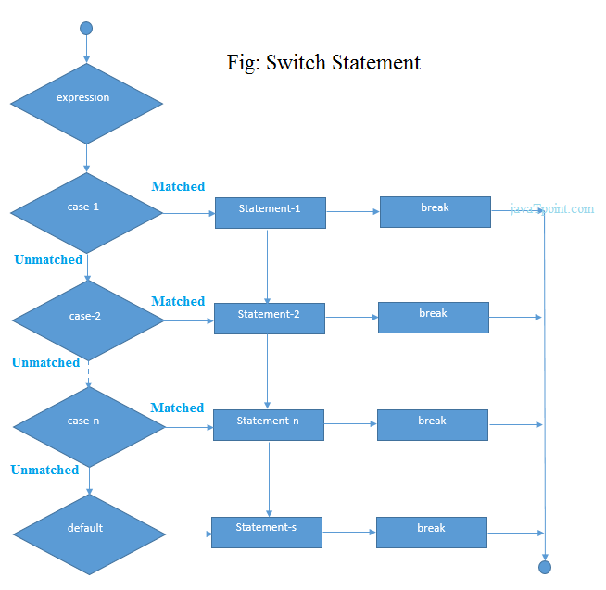

Slide 27
Write a menu driven program for restaurant menu
Momo
Pizza
Noodles
Burger
Fry Rice
Exit

Slide 28
Example
#include <stdio.h>
int main() {
int ID = 500;
int password = 000;
printf("Plese Enter Your ID:\n ");
scanf("%d", & ID);
switch (ID) {
case 500:
printf("Enter your password:\n ");
scanf("%d", & password);

Slide 29
switch (password) {
case 000:
printf("Welcome Dear Programmer\n");
break;
default:
printf("incorrect password");
break;
}
break;
default:
printf("incorrect ID");
break;
}
}

Slide 30
Repetitive Statement
A repetition statement allows you to specify that an action is to be repeated while some condition remains true.
Loops are used when we want to execute a part of program or block of statement several times
There are three types of loops
The while loop
The do while loop
The for loop
Each loop consist of two segments, one is known as the control statement and the other is the body of the loop
Loop may be classified either entry-controlled loop or exit-controlled loop.

Slide 31
The while loop
The syntax of a while loop is:
while (testExpression)
{
//codes
}
How while loop works?
The while loop evaluates the test expression.
If the test expression is true (nonzero), codes inside the body of while loop is executed. The test expression is evaluated again. The process goes on until the test expression is false.
When the test expression is false, the while loop is terminated.

Slide 32
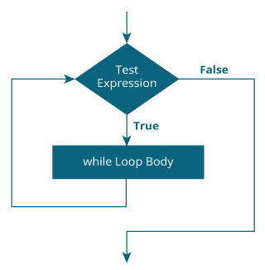

Slide 33
Write a program to print Hello World five times.
WAP to print all even numbers between 30-60
WAP to find sum of first 10 natural numbers
WAP to check whether the given number is prime or not.

Slide 34
The do...while loop
The do..while loop is similar to the while loop with one important difference. The body of do...while loop is executed once, before checking the test expression. Hence, the do...while loop is executed at least once.
do...while loop Syntax
do
{
// codes
} while (testExpression);

Slide 35
How do...while loop works?
The code block (loop body) inside the braces is executed once.
Then, the test expression is evaluated. If the test expression is true, the loop body is executed again. This process goes on until the test expression is evaluated to 0 (false).
When the test expression is false (nonzero), the do...while loop is terminated.

Slide 36
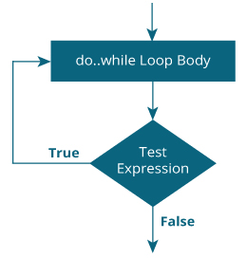

Slide 37
Write a program to print Hello World five times using do while loop.

Slide 38


Slide 39
The for loop
The syntax of for loop is:
for (initialization; testExpression; updateStatement)
{
// codes
}
How for loop works?
The initialization statement is executed only once.
Then, the test expression is evaluated. If the test expression is false (0), for loop is terminated. But if the test expression is true (nonzero), codes inside the body of for loop is executed and the update expression is updated.
This process repeats until the test expression is false.
The for loop is commonly used when the number of iterations is known.

Slide 40
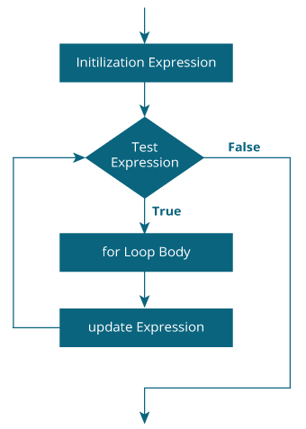

Slide 41
Write a program to print Hello World five times using for loop.

Slide 42
Nested loop in C
C programming allows to use one loop inside another loop. The following section shows a few examples to illustrate the concept.
The syntax for a nested for loop statement in C is as follows
for ( init; condition; increment )
{
for ( init; condition; increment )
{
statement(s);
}
statement(s);
}

Slide 43
The syntax for a nested while loop statement in C programming language is as follows
while(condition)
{
while(condition)
{
statement(s);
}
statement(s);
}

Slide 44
The syntax for a nested do...while loop statement in C programming language is as follows −
do
{
statement(s);
do
{
statement(s);
}while( condition );
}while( condition );

Slide 45
C Jump Statements
Jump statements are used to interrupt the normal flow of program.
Types of Jump Statements
Break
Continue
GoTo

Slide 46
Break Statement
The break statement is used inside loop or switch statement.
When compiler finds the break statement inside a loop, compiler will abort the loop and continue to execute statements followed by loop.

Slide 47
Example
#include<stdio.h>
void main()
{
int a=1;
while(a<=10)
{
if(a==5){
break;
}
printf("\nHello %d.",a);
a++;
}
printf("\nEnd of Program.");
}

Slide 48
Continue Statement
The continue statement is also used inside loop.
When compiler finds the continue statement inside a loop, compiler will skip all the following statements in the loop and resume the loop.

Slide 49
Example
#include<stdio.h>
void main()
{
int a=0;
while(a<10)
{
a++;
if(a==5){
continue;
}
printf("\nHello %d.",a);
}
printf("\nEnd of Program.");
}

Slide 50
goto Statement
The goto statement is a jump statement which jumps from one point to another point within a function.
Syntax of goto statement
goto label;
- - - - - - - - - -
- - - - - - - - - -
label:
- - - - - - - - - -
- - - - - - - - - -
In the above syntax, label is an identifier. When, the control of program reaches to goto statement, the control of the program will jump to the label: and executes the code after it.

Slide 51
Example
#include<stdio.h>
void main()
{
printf("\nStatement 1.");
printf("\nStatement 2.");
printf("\nStatement 3.");
goto last;
printf("\nStatement 4.");
printf("\nStatement 5.");
last:
printf("\nEnd of Program.");
}

